Slide 1


Slide 2
UART Transmitter FPGA Design
Now that you understand how the UART protocol works, we need to create a design to implement it.

Slide 3
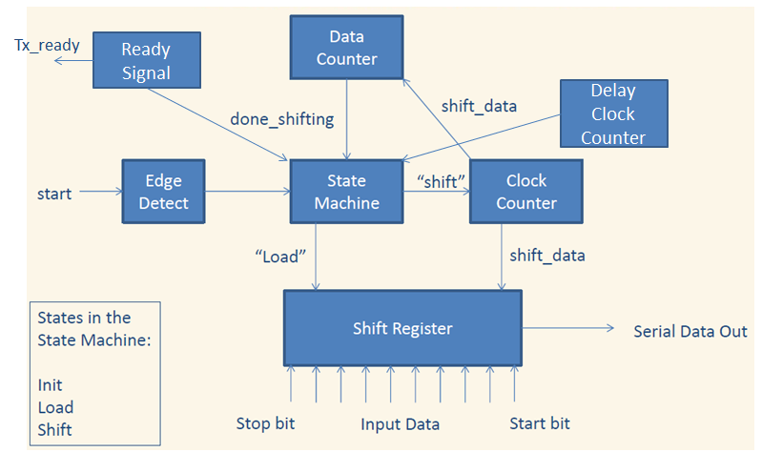
Transmitter Design Overview

Slide 4
Transmitter Design
We will have the following in the generic section of our design:
Baud
Clock rate
This will be used to calculate how many clock cycles need to be counted in order to transmit data at the desired baud rate

Slide 5
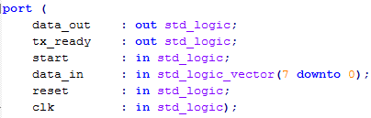
Transmitter Design
We will have the following in the port of our design:
The port and generics are already defined in the code I have provided you with.

Slide 6
Transmitter Processes
State_proc and nxt_state_proc are used to implement the state machine.
Begin_trans_proc is used to detect when the ‘start’ input is set high. This is what starts our state machine.
Count_bits_proc is used to count the number of bits we have sent out. We also shift the data out here as well as load data.
Count_clock_proc is used to generate the desired baud rate.
Count_delay_proc is used to generate a delay that delays the tx_ready signal from going high too soon.
Tx_ready_proc is used to indicate when the transmitter is ready to transmit more data.

Slide 7
Edge Detection Circuitry
We want to have a trigger that only fires on the rising edge of our input.
If we didn’t do this we would try to transmit twice, causing our transmitter to fail.
This will be used throughout this course, so once you have it designed here you can re-use this.
Read the comments in the code, they will help you in designing this portion of the UART design.

Slide 8
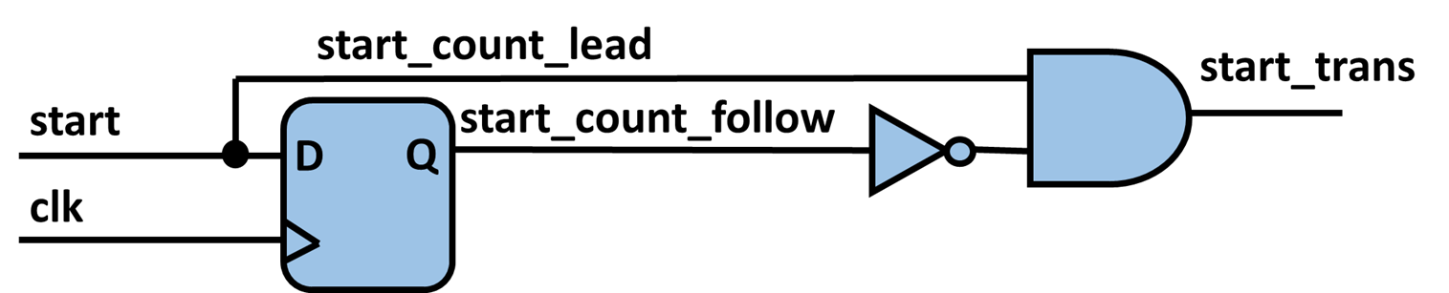
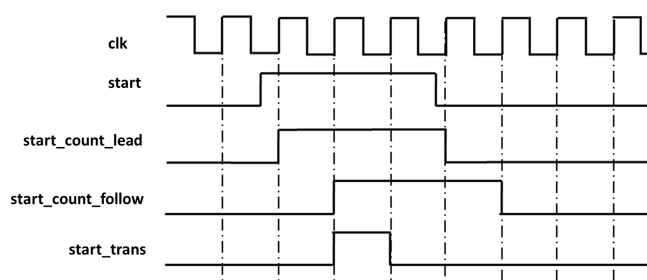
Edge Detection Circuitry Layout

Slide 9
Review
All the processes are laid out and defined in the code I have provided you as a starting point.
There are also comments in the code to help you if you get stuck.
Remember to use any PDF’s included with the design files as a reference that help layout the design.

